Slide 1
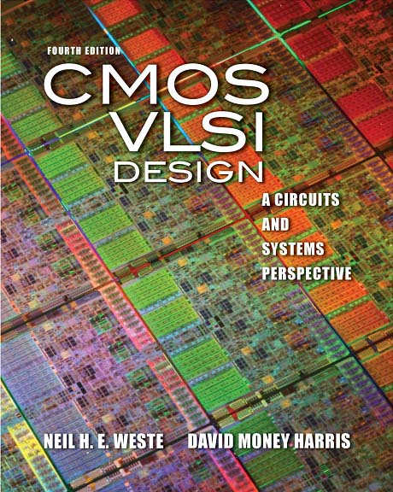
Lecture 2: ARM Processor Example

Slide 2
Outline
Design Partitioning
ARM Processor Example
Architecture
Microarchitecture
Logic Design
Circuit Design
Physical Design
Fabrication, Packaging, Testing

Slide 3
Activity 2
Sketch a stick diagram for a 4-input NOR gate

Slide 4
Coping with Complexity
How to design System-on-Chip?
Many millions (even billions!) of transistors
Tens to hundreds of engineers
Structured Design
Design Partitioning

Slide 5
Structured Design
Hierarchy: Divide and Conquer
Recursively system into modules
Regularity
Reuse modules wherever possible
Ex: Standard cell library
Modularity: well-formed interfaces
Allows modules to be treated as black boxes
Locality
Physical and temporal

Slide 6
Design Partitioning
Architecture: User’s perspective, what does it do?
Instruction set, registers
ARM, MIPS, x86, Alpha, PIC, RISC-V, …
Microarchitecture
Single cycle, multicycle, pipelined, superscalar?
Logic: how are functional blocks constructed
Ripple carry, carry lookahead, carry select adders
Circuit: how are transistors used
Complementary CMOS, pass transistors, domino
Physical: chip layout
Datapaths, memories, random logic

Slide 7
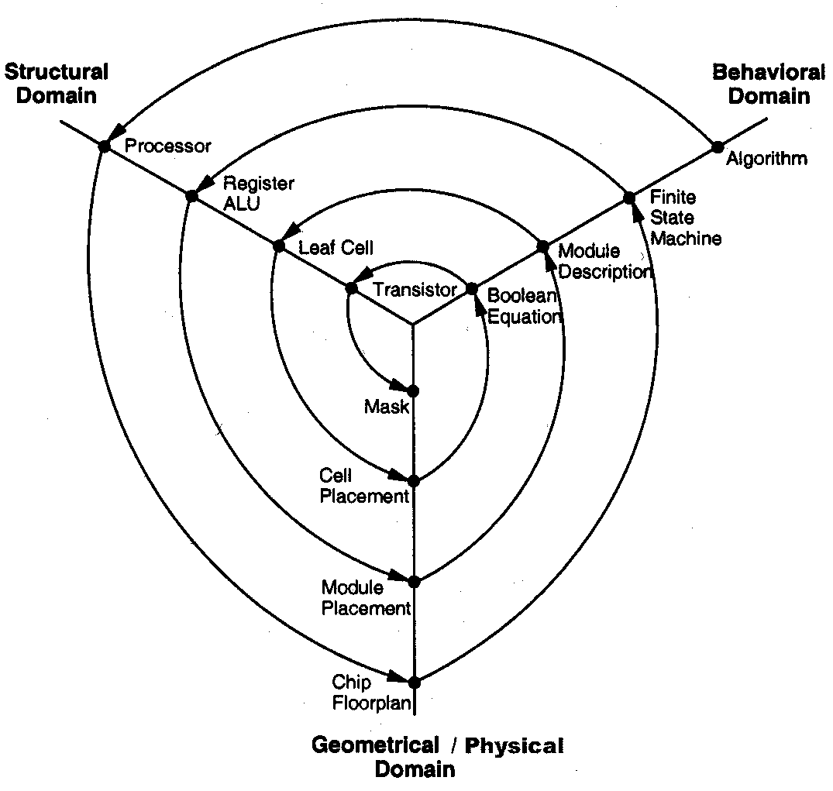
Gajski Y-Chart

Slide 8
ARM Architecture
Example: subset of ARM processor architecture
Drawn from DDCA ARM Ed. (Harris & Harris)
ARM is a 32-bit architecture with 16 registers
Consider 8-bit subset using 8-bit datapath
Only implement 8 registers (R0 - R7)
8-bit program counter in R7
You’ll build this processor in the labs
Illustrate the key concepts in VLSI design

Slide 9
Instruction Set
Data Processing
ADD, SUB, AND, OR
Each accepts register / immediate 2nd sources
Memory
LDR, STR
Positive immediate offset
Branch
B

Slide 10
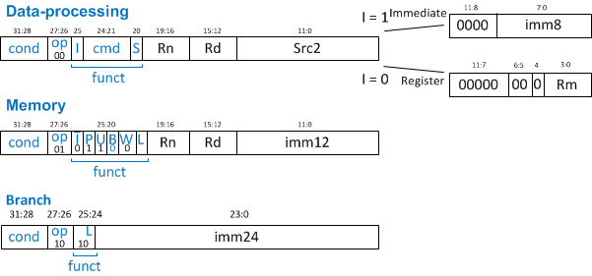
Instruction Encoding
32-bit instruction encoding
Requires four cycles to fetch on 8-bit datapath
cmd | instr
0100 | ADD
0010 | SUB
0000 | AND
1100 | OR

Slide 11
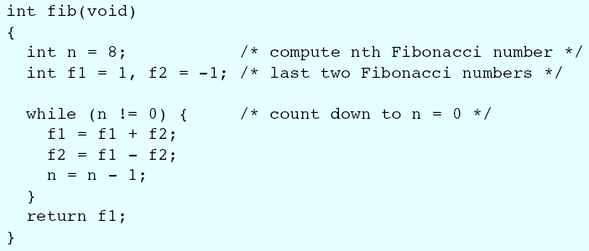
Fibonacci (C)
f₀ = 1; f₋₁ = -1
f_{n} = f_{n-1} + f_{n-2}
f = 1, 1, 2, 3, 5, 8, 13, …

Slide 12
Fibonacci (Assembly)
# fib.asm
# Register usage: R0 = 0, R3 = n, R4 = f1, R5 = f2
# Put result in address 255
fib add R3, R0, #8 # initialize n = 8
add R4, R0, #1 # initialize f1 = 1
add R5, R0, #-1 # initialize f2 = -1
loop subs R3, R0, end # n = 0?
beq done # then done
add R4, R4, R5 # f1 = f1 + f2
sub R5, R4, R5 # f2 = f1 – f2
add R3, R3, #-1 # n = n-1
b loop # repeat until done
done str R4, [R0, #255] # store result in adr 255

Slide 13
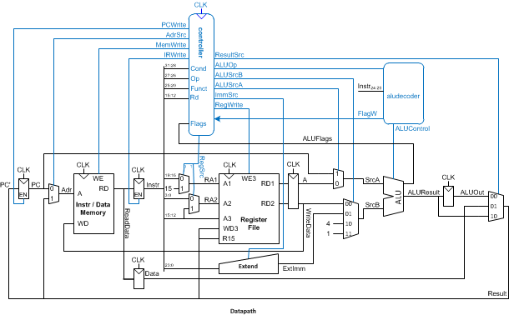
ARM Microarchitecture
Multicycle μarchitecture ( Harris DDCA ARM Ed.)

Slide 14
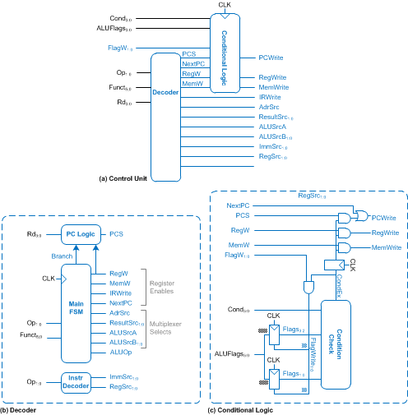
Multicycle Controller

Slide 15
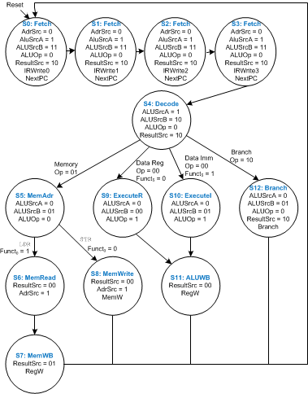
Multicycle FSM

Slide 16
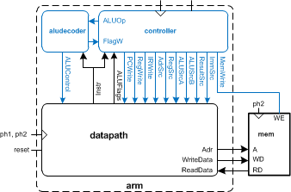
Logic Design
Start at top level
Hierarchically decompose ARM into units

Slide 17
Hierarchical Design
arm

Slide 18
HDLs
Hardware Description Languages
Widely used in logic design
Verilog and VHDL
Describe hardware using code
Document logic functions
Simulate logic before building
Synthesize code into gates and layout
Requires a library of standard cells

Slide 19
Verilog Example
module fulladder(input a, b, c,
output s, cout);
sum s1(a, b, c, s);
carry c1(a, b, c, cout);
endmodule
module carry(input a, b, c,
output cout)
assign cout = (a&b) | (a&c) | (b&c);
endmodule

Slide 20
Circuit Design
How should logic be implemented?
NANDs and NORs vs. ANDs and ORs?
Fan-in and fan-out?
How wide should transistors be?
These choices affect speed, area, power
Logic synthesis makes these choices for you
Good enough for many applications
Hand-crafted circuits are still better

Slide 21
Example: Carry Logic
assign cout = (a&b) | (a&c) | (b&c);
Transistors? Gate Delays?

Slide 22
Gate-level Netlist
module carry(input a, b, c,
output cout)
wire x, y, z;
and g1(x, a, b);
and g2(y, a, c);
and g3(z, b, c);
or g4(cout, x, y, z);
endmodule

Slide 23
Transistor-Level Netlist
module carry(input a, b, c,
output cout)
wire i1, i2, i3, i4, cn;
tranif1 n1(i1, 0, a);
tranif1 n2(i1, 0, b);
tranif1 n3(cn, i1, c);
tranif1 n4(i2, 0, b);
tranif1 n5(cn, i2, a);
tranif0 p1(i3, 1, a);
tranif0 p2(i3, 1, b);
tranif0 p3(cn, i3, c);
tranif0 p4(i4, 1, b);
tranif0 p5(cn, i4, a);
tranif1 n6(cout, 0, cn);
tranif0 p6(cout, 1, cn);
endmodule

Slide 24
SPICE Netlist
.SUBCKT CARRY A B C COUT VDD GND
MN1 I1 A GND GND NMOS W=1U L=0.18U AD=0.3P AS=0.5P
MN2 I1 B GND GND NMOS W=1U L=0.18U AD=0.3P AS=0.5P
MN3 CN C I1 GND NMOS W=1U L=0.18U AD=0.5P AS=0.5P
MN4 I2 B GND GND NMOS W=1U L=0.18U AD=0.15P AS=0.5P
MN5 CN A I2 GND NMOS W=1U L=0.18U AD=0.5P AS=0.15P
MP1 I3 A VDD VDD PMOS W=2U L=0.18U AD=0.6P AS=1 P
MP2 I3 B VDD VDD PMOS W=2U L=0.18U AD=0.6P AS=1P
MP3 CN C I3 VDD PMOS W=2U L=0.18U AD=1P AS=1P
MP4 I4 B VDD VDD PMOS W=2U L=0.18U AD=0.3P AS=1P
MP5 CN A I4 VDD PMOS W=2U L=0.18U AD=1P AS=0.3P
MN6 COUT CN GND GND NMOS W=2U L=0.18U AD=1P AS=1P
MP6 COUT CN VDD VDD PMOS W=4U L=0.18U AD=2P AS=2P
CI1 I1 GND 2FF
CI3 I3 GND 3FF
CA A GND 4FF
CB B GND 4FF
CC C GND 2FF
CCN CN GND 4FF
CCOUT COUT GND 2FF
.ENDS

Slide 25
Physical Design
Floorplan
Standard cells
Place & route
Datapaths
Slice planning
Area estimation

Slide 26
ARM Floorplan

Slide 27
ARM Layout

Slide 28
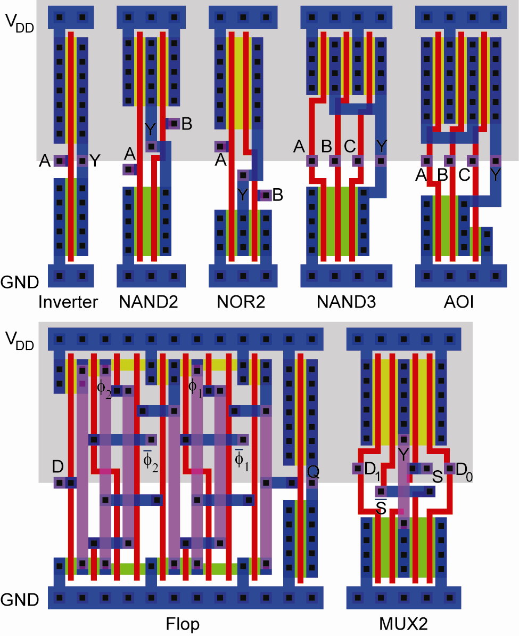
Standard Cells
Uniform cell height
Uniform well height
M1 V_{DD} and GND rails
M2 Access to I/Os
Well / substrate taps
Exploits regularity

Slide 29
Synthesized Controller
Synthesize HDL into gate-level netlist
Place & Route using standard cell library

Slide 30
Pitch Matching
Synthesized controller area is mostly wires
Design is smaller if wires run through/over cells
Smaller = faster, lower power as well!
Design snap-together cells for datapaths and arrays
Plan wires into cells
Connect by abutment
Exploits locality
Takes lots of effort

Slide 31
ARM Datapath
8-bit datapath built from wordlices
Zipper at top drives control signals to datapath
Register File Decoder
Zipper
Bitslide 7
Bitslide 1
Flop Wordslide
Adder Wordslide

Slide 32
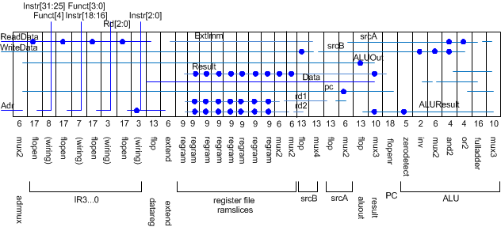
Slice Plans
Slice plan for bitslice
Cell ordering, dimensions, wiring tracks
Arrange cells for wiring locality

Slide 33
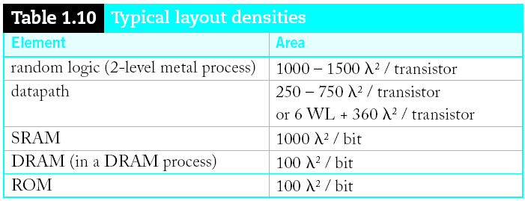
Area Estimation
Need area estimates to make floorplan
Compare to another block you already designed
Or estimate from transistor counts
Budget room for large wiring tracks
Your mileage may vary; derate by 2x for class.

Slide 34
Design Verification
Fabrication is slow & expensive
MOSIS 0.6μm: $1000, 3 months
65 nm: $3M, 1 month
Debugging chips is very hard
Limited visibility into operation
Prove design is right before building!
Logic simulation
Ckt. simulation / formal verification
Layout vs. schematic comparison
Design & electrical rule checks
Verification is > 50% of effort on most chips!

Slide 35
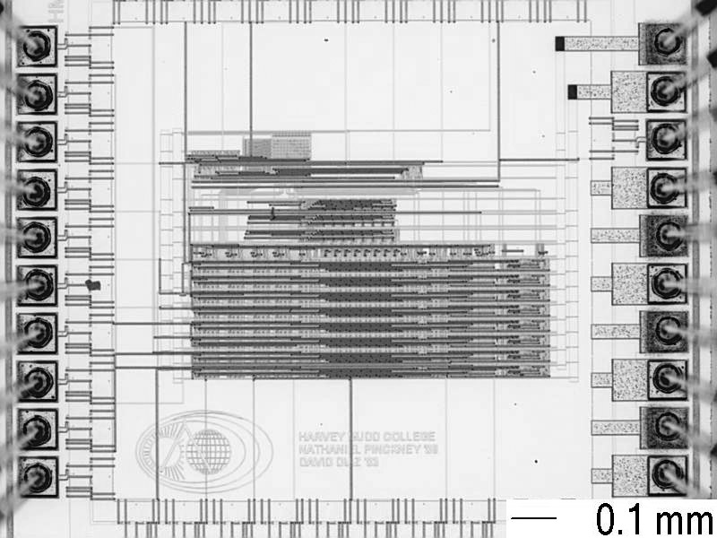
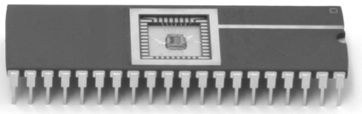
Fabrication & Packaging
Tapeout final layout
Fabrication
6, 8, 12” wafers
Optimized for throughput,
not latency (10 weeks!)
Cut into individual dice
Packaging
Bond gold wires from die I/O pads to package

Slide 36
Testing
Test that chip operates
Design errors
Manufacturing errors
A single dust particle or wafer defect kills a die
Yields from 90% to < 10%
Depends on die size, maturity of process
Test each part before shipping to customer

Slide 37
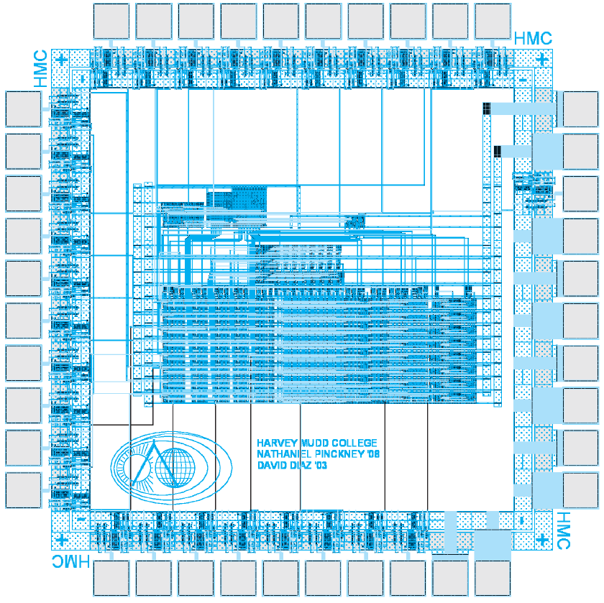
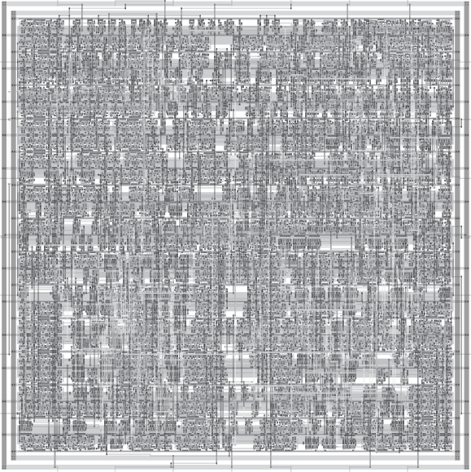
Custom vs. Synthesis
8-bit Implementations

Slide 38
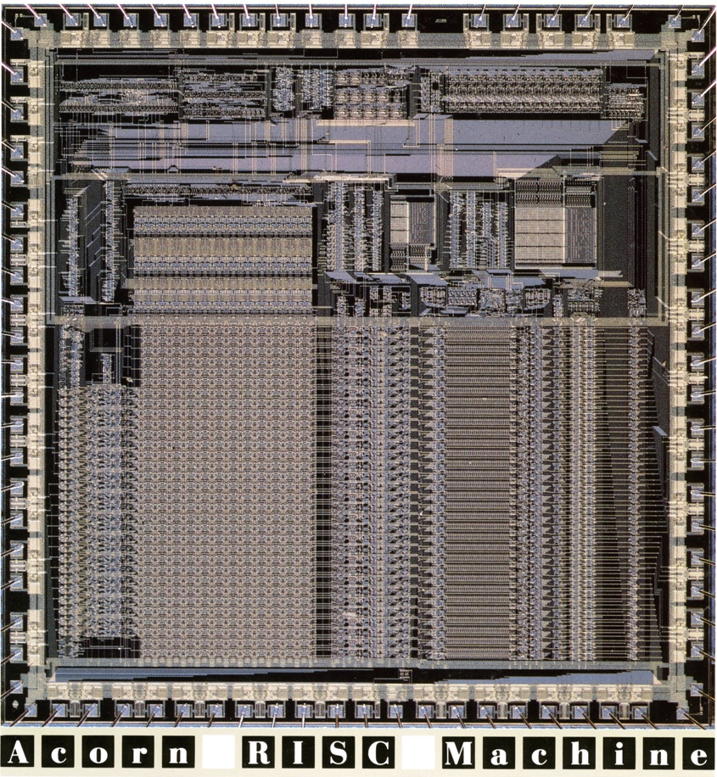
ARM1 Processor
1st generation ARM chip (1985)
24,800 transistors
3-stage pipeline
8 MHz
3 μm process
49 mm²
82-pin PLCC package
Average power = 0.1 W
2-phase nonoverlapping
clocks
Built for Acorn Computer
© 1985 ARM Ltd.

